Slide 1

NNVHC AGM Presentation
Marc Johnson – Community Development Officer
1st July 2024

Slide 2

My Background
Born in Alnwick, brought up in Whittingham BSc in Environmental Studies
Rural Transport Partnership Officer at NCC (2000 – 2006)
Community Development Officer at CAN (2006 – 2014)
Funding Officer / VCS Support Services Manager at NCVA (2014 – 2024)
3rd June 2024 Community Development Officer at CAN Trustee of a local youth charity

Slide 3
Job Role
Job Title: Community Development Officer
Warm Hubs Co-ordinator (2 days per week) Rural Digital Inclusion Project (2 days per week) Village Hall Advice (1 day per week)
Rural Transport (No allocation)
NB. days are an approximation

Slide 4
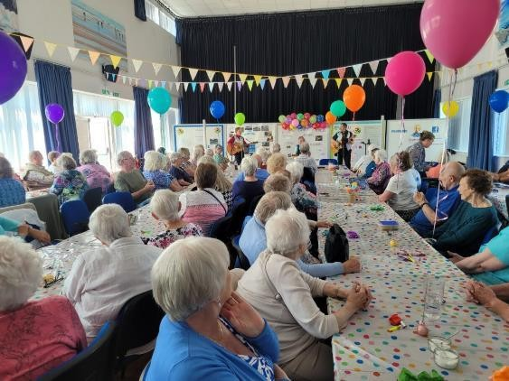
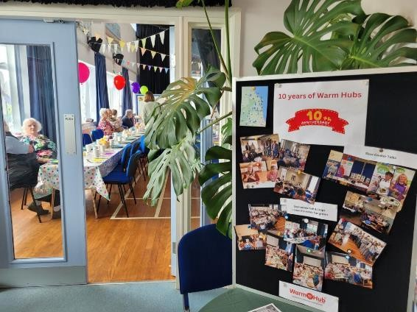
Warm Hubs
Support the 55 existing Warm Hubs Develop new Warm Hubs
Manage the Warm Hub Toolkit (National)

Slide 5
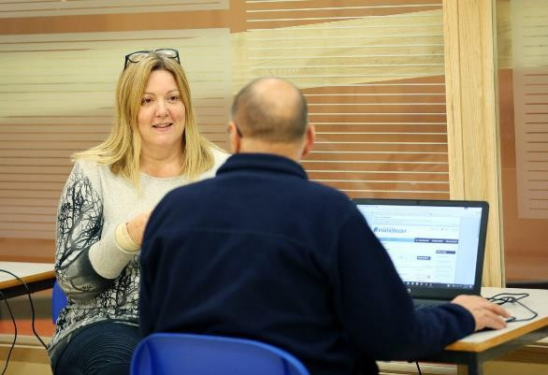
Rural Digital Inclusion Project
Free broadband connections from suppliers (not all halls)
Recruit & train ‘Digital Champions’
Help to develop / link to existing activities - ‘Techy Tea Party’ etc.
Project starts in September

Slide 6
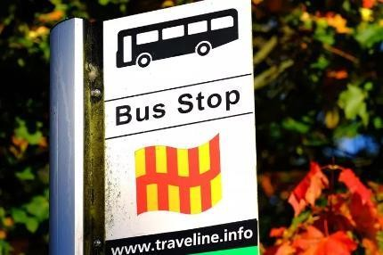
Rural Transport
No specific time allocation Watching brief
North East Mayoral Authority / NCC

Slide 7
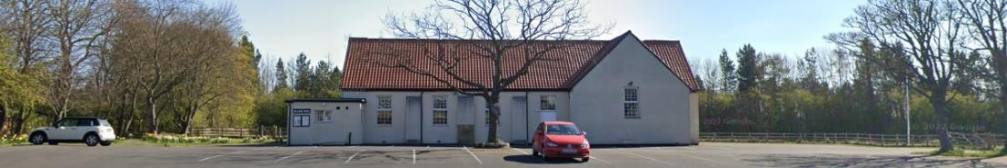
Community Foundation - Time to Talk Session
Friday 5th July 2024, 1pm to 2:45pm
Stannington Village Hall
Time to Talk sessions are open to anyone connected with a charitable organisation or support agency. We welcome volunteers, staff members, consultants, fundraisers and trustees. The event will begin with a presentation about accessing support from Community Foundation, followed by the opportunity to share thoughts, ideas and good practice.
Contact Tracey to book.

Slide 8
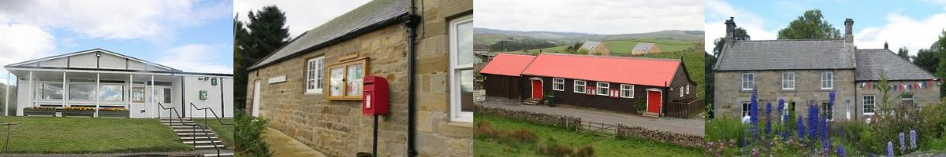
Village Hall Advice
1 day per week to support Tracey
5 days per week of generic Village Hall Advice Service
Reduction from 7 days per week (supplemented by digital & Warm Hubs)
Our challenge: Can we offer a better service with less resource?
What are your priorities for support?

Slide 9
Contacts
Marc Johnson
marcjohnson@ca-north.org.uk
07477 961096
Facebook: work account Marc Johnson

